Slide 1
Group 2
Paul Kruchko (EE)
Michael Laba (ME)
Bryan Jagielo (EE/CE)
Xiaoang Tong (EE)
Monika Shaeff (CE)
Ran Ao (ME)
Xinfeng Shi (ME)

Slide 2
Design Overview: Definition of our design
Our design is a closed-loop, feed-back, electronically controlled rotating part feeder that agitates, actuates, and organizes a set of homogenous hardware components that are to be counted and dispensed into the awaiting hands of the operator/user.

Slide 3
Part movement
Uses a bowl and wheel method to agitate, and dispense parts into awaiting presentation bin.
Uses geometry of replaceable disks to orient and move parts one at a time.
Gravity fed disk on 45 degrees.
Uses adjustable motor speed from EMF feed back to ensure no parts are ejected from the machine.

Slide 4
Part Movement continued
Gravity fed chute and presentation bin.
When bin is activated parts are dispensed in a controlled manor.
By limiting part feed to presentation bin to one at a time, we allow our sensors to accurately count each falling part.
Limiting the number of parts the disk can move at any given time allows for time to shut down the machine when part counts have been reached.

Slide 5
Frame
All features are contained in our compact frame.
Tight packaging in design limits our table space impact, also allows for the machine to be unplugged and moved.
Machine weighs _____ pounds. Making it an easy machine to be moved by one person if needed.
20mmx20mm 80/20 extrude allows for parts to be assembled easily and by means of fastener. This allows for higher survicablity if parts brake.

Slide 6
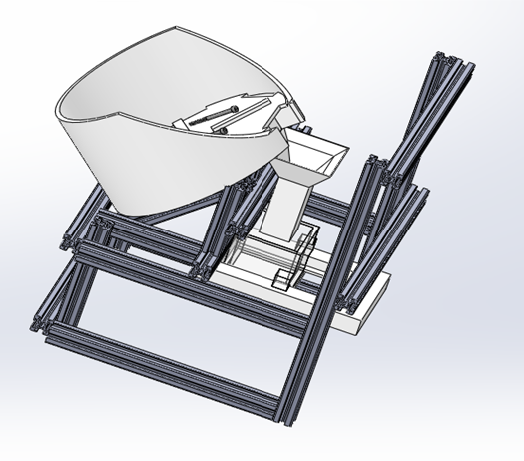

Slide 7
Printed Disks
Design had originally been 1 disk with inserts. (messy)
Fast installation for part switch
Maintain bowl inserts to keep disks thin and improve manufacturing time.
Agitators are thin but effective in mixing and orienting main part population.

Slide 8
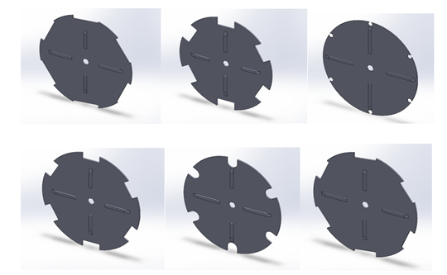

Slide 9
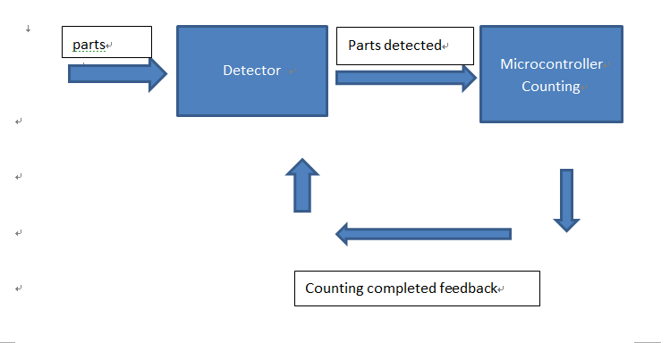
Device Performance and System controls (counting)- Flow chart

Slide 10
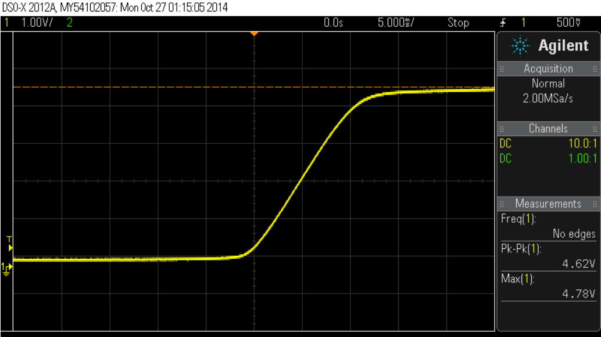
Device Performance and System controls (counting)
Detective System and Counting System:
1.Sensor : high Sensitivity-15us for rising edge (10+ testing for each part proofed)

Slide 11
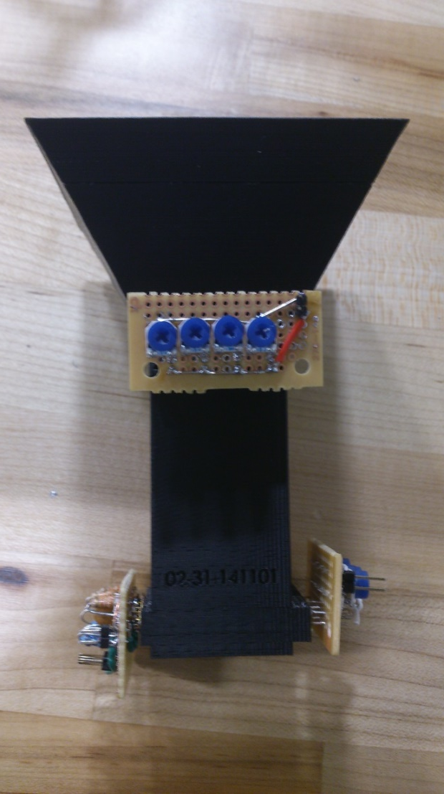
Device Performance and System controls (counting)
2.safety- 2 layers, grid structure . No gaps for parts escape detection system.
- closed space for sensor working, less external disturbing will be happened during detection
- depend on gravity accelerate theory, when the part go through the sensor,the fastest speed is approximately 2.2m/s. For a nut which has 4mm height, when it passes the sensor it will take 1.82ms which is much higher than our sensor’s reflection time 15us.

Slide 12
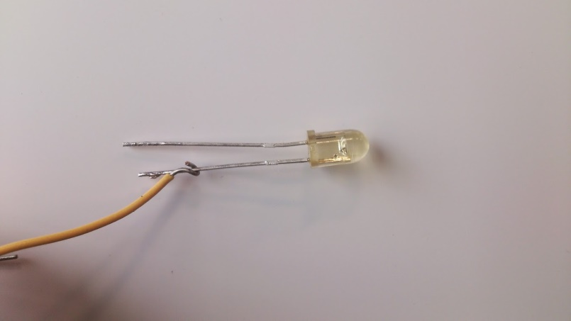
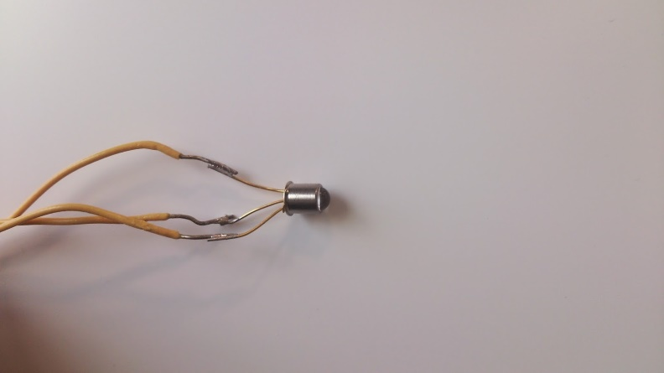
Device Performance and System controls (counting)
3. High efficiency Coding: uses state machine, typedef and boolen type
4. Minimize cost:
Detective system was built up with the most basic component, and technique of IR sensor is already a mature technique with super low price.

Slide 13
Testing results

Slide 14
Device Performance and System controls (motor)
motor performance :

Slide 15
Device Performance and System controls (motor)
Variable feedback on the motor allows for motor speed change when major part population has decreased.
Examples.

Slide 16
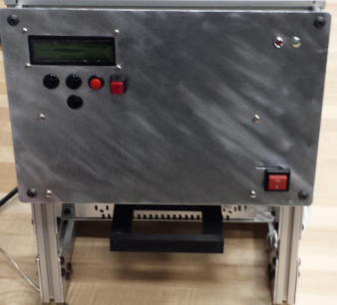
User interface
Uses Lcd Screen with button input that allows the user to select parts and counts.
Humanity design for user which allows the user to pause the system working and to go back to previous step with pause and cancel button.
LEDs alert user to when count is ready or if there is an error.
Easy power up and power down.
Part dispenser is user activated and provides feedback to user when parts are dispensed.

Slide 17
How it all works
Parts are chosen and the machine is set up.
User interface selects parts and part count
Press start count button to activate machine
The machine works for no more than 30sec before alerting the user that the count is ready.
User pushes on the parts slider like a soap dispenser, dropping the parts into the user’s hand and signaling to the machine that the count has been delivered.

Slide 18
Video

Slide 19
Advantages
Product is easy to use and compact enough to fit in most shops or on the floor of a manufacturing facility.
Parts are dispensed in 30 seconds and can be set to refill automatically after the user is finished dispensing.
The sensors are layered and set in a grid to ensure correct count.
All the ME/EE subsystems are all in the same whole frame, convenient to move and operate.(Optimized Structure)

Slide 20
Why we are going to win
From testing we are able to dispense each part accurately for each number variation.
We have organized all of our inserts and disks needed for each fastener.

